Slide 1
DD2421 LAB 3: BAYESIAN LEARNING AND BOOSTING

Slide 2
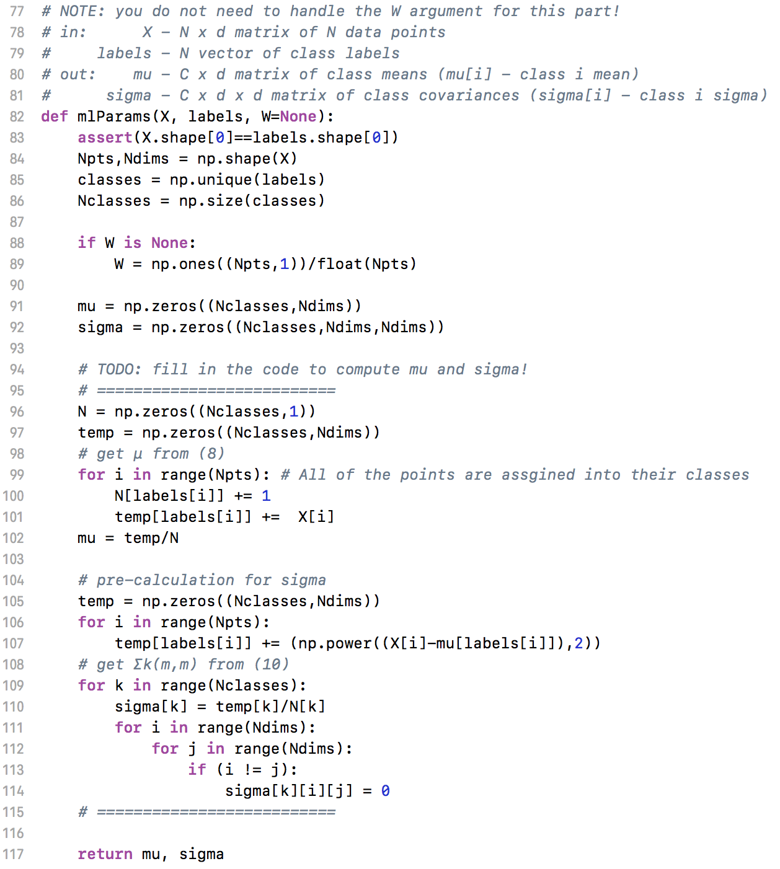
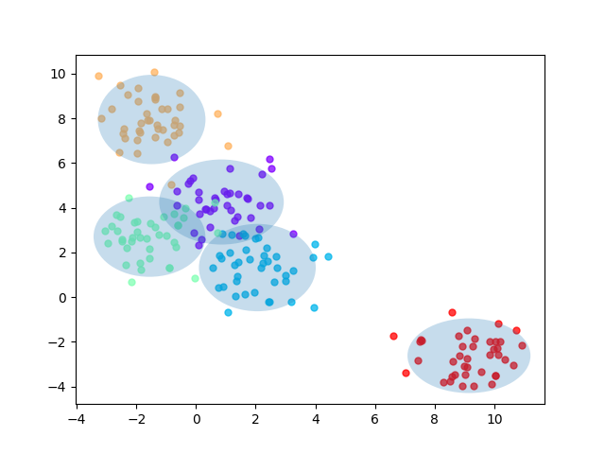
Assignment 1

Slide 3
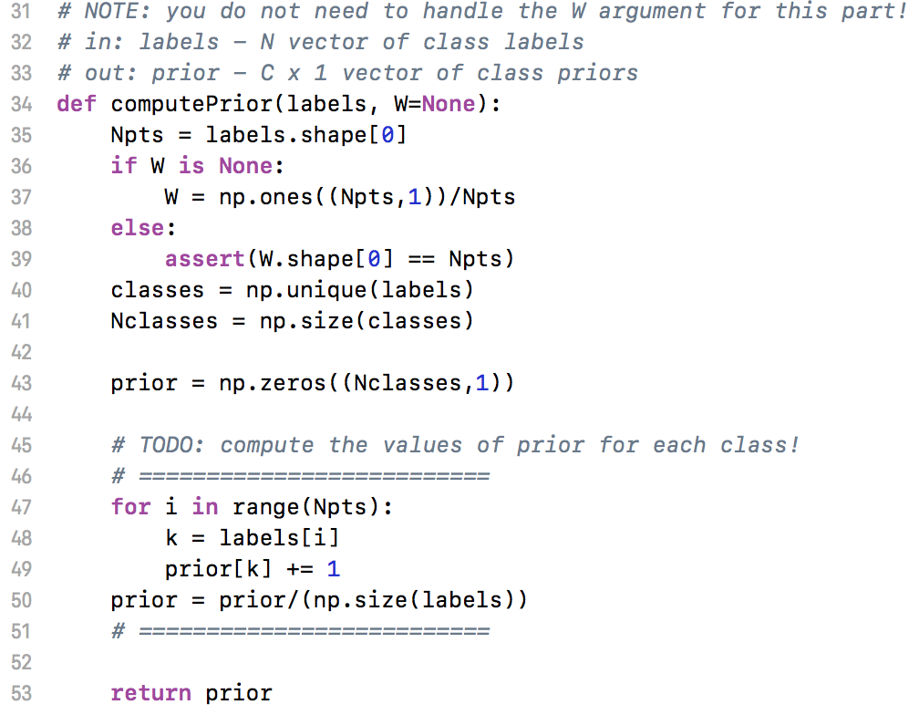
Assignment 2

Slide 4
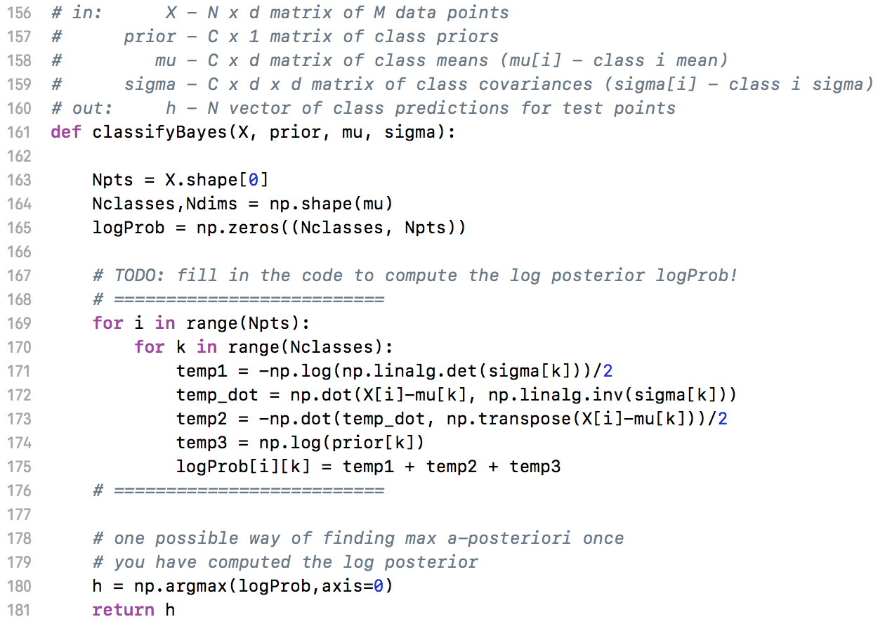
Assignment 2

Slide 5
Assignment 3
When can a feature independence assumption be reasonable and when not?
The Bayes classifier assumes that the features in their dataset are independent of others (named “Naïve”). In the real world, features are not totally independent together, like “sepal length” and “sepal width” in Iris dataset.
However, with a feature independence assumption, the Naïve Bayes model resulted in high accuracy.
However, if the different classes’ feature vector locate near together, it will not become reasonable, such as “Vowel” dataset.

Slide 6
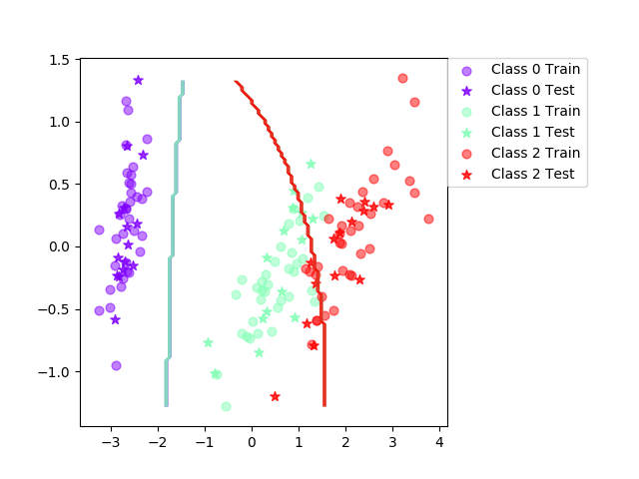
Assignment 3
dataset=iris, split=0.7
Trial: 0 Accuracy 84.4
Trial: 10 Accuracy 95.6
Trial: 20 Accuracy 93.3
Trial: 30 Accuracy 86.7
Trial: 40 Accuracy 88.9
Trial: 50 Accuracy 91.1
Trial: 60 Accuracy 86.7
Trial: 70 Accuracy 91.1
Trial: 80 Accuracy 86.7
Trial: 90 Accuracy 91.1
Final mean classification accuracy 89
with standard deviation 4.16

Slide 7
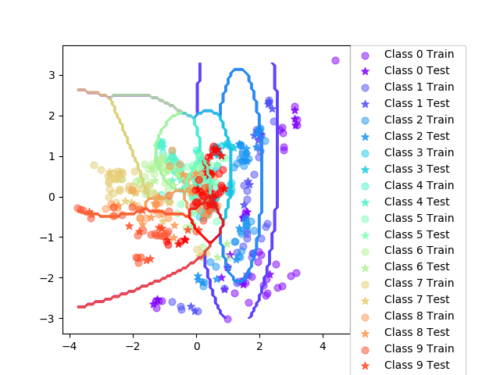
Assignment 3
dataset=vowel, split=0.7
Trial: 0 Accuracy 61
Trial: 10 Accuracy 66.2
Trial: 20 Accuracy 74
Trial: 30 Accuracy 66.9
Trial: 40 Accuracy 59.7
Trial: 50 Accuracy 64.3
Trial: 60 Accuracy 66.9
Trial: 70 Accuracy 63.6
Trial: 80 Accuracy 62.3
Trial: 90 Accuracy 70.8
Final mean classification accuracy 64.7 with standard deviation 4.03

Slide 8

Assignment 3
(2) How does the decision boundary look for the Iris dataset? How could one improve the classification results for this scenario by changing classifier or, alternatively, manipulating the data?
Bayes Classifier (Iris)
The datasets have some duplicate points between different classes.
So, we can improve the result with changing the classifier to SVM. SVM can treat those misclassifying data points by setting slack values and slack parameter.

Slide 9
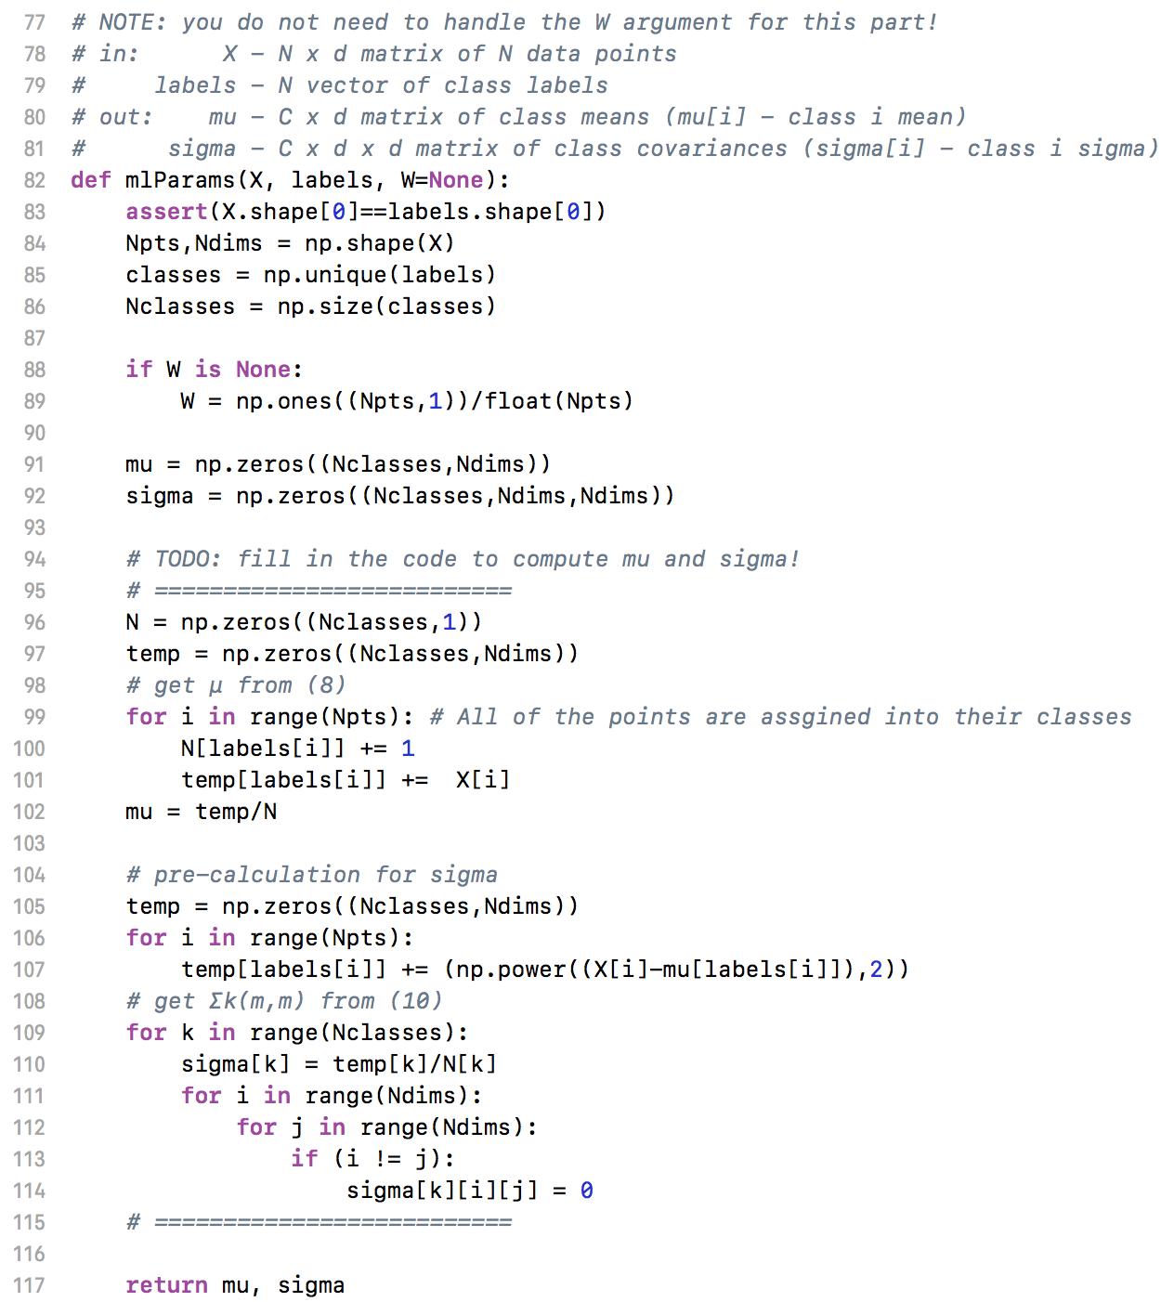
Assignment 4

Slide 10
Assignment 5 (1) Is there any improvement in classification accuracy? Why/why not?
dataset=iris, split=0.7
Trial: 0 Accuracy 84.4
Trial: 10 Accuracy 95.6
Trial: 20 Accuracy 93.3
Trial: 30 Accuracy 86.7
Trial: 40 Accuracy 88.9
Trial: 50 Accuracy 91.1
Trial: 60 Accuracy 86.7
Trial: 70 Accuracy 91.1
Trial: 80 Accuracy 86.7
Trial: 90 Accuracy 91.1
Final mean classification accuracy 89 with standard deviation 4.16
Trial: 0 Accuracy 95.6
Trial: 10 Accuracy 97.8
Trial: 20 Accuracy 93.3
Trial: 30 Accuracy 93.3
Trial: 40 Accuracy 97.8
Trial: 50 Accuracy 93.3
Trial: 60 Accuracy 95.6
Trial: 70 Accuracy 95.6
Trial: 80 Accuracy 93.3
Trial: 90 Accuracy 93.3
Final mean classification accuracy 94.5 with standard deviation 2.92

Slide 11
Assignment 5 (1) Is there any improvement in classification accuracy? Why/why not?
dataset=vowel, split=0.7
Trial: 0 Accuracy 61
Trial: 10 Accuracy 66.2
Trial: 20 Accuracy 74
Trial: 30 Accuracy 66.9
Trial: 40 Accuracy 59.7
Trial: 50 Accuracy 64.3
Trial: 60 Accuracy 66.9
Trial: 70 Accuracy 63.6
Trial: 80 Accuracy 62.3
Trial: 90 Accuracy 70.8
Final mean classification accuracy 64.7 with standard deviation 4.03
Trial: 0 Accuracy 68.2
Trial: 10 Accuracy 68.8
Trial: 20 Accuracy 74
Trial: 30 Accuracy 70.1
Trial: 40 Accuracy 67.5
Trial: 50 Accuracy 69.5
Trial: 60 Accuracy 72.1
Trial: 70 Accuracy 68.8
Trial: 80 Accuracy 73.4
Trial: 90 Accuracy 70.8
Final mean classification accuracy 71.3 with standard deviation 4.62

Slide 12
Assignment 5 (1) Is there any improvement in classification accuracy? Why/why not?
There are improvements in both Iris and Vowel datasets.
Those improvements thanks to the boosting.
In boosting, we can weight the missclassified samples and build more accurate model.

Slide 13
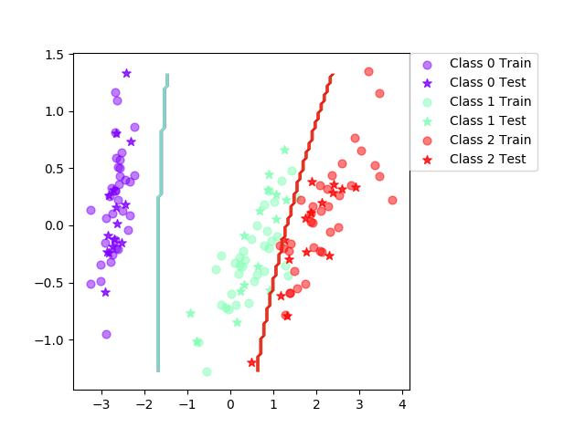
Assignment 5 (2) Plot the decision boundary of the boosted classifier on iris and compare it with that of the basic. What differences do you notice? Is the boundary of the boosted version more complex?
We cannot say the boundary become more complex, but it is clear the boundary fits better data points.

Slide 14
Assignment 5 (3) Can we make up for not using a more advanced model in the basic classifier (e.g. independent features) by using boosting?
Yes, we can make better models not with advanced models, but with weak classifiers.
But, those classifiers should produce 50% accuracy without boosting.

Slide 15
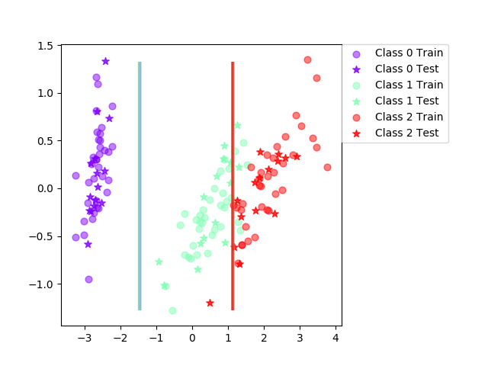
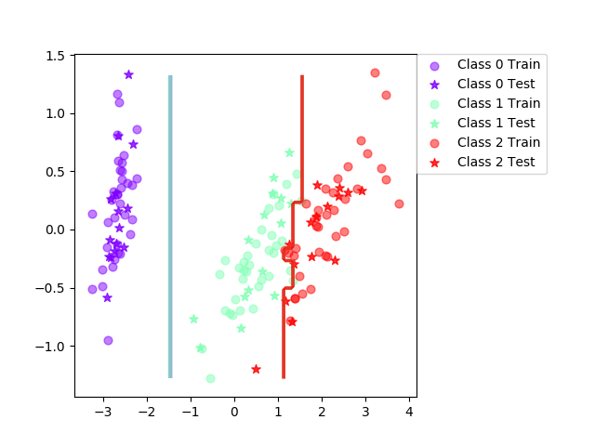
Assignment 6 (Iris)
Decision Tree
Boosting (Decision Tree, T=10)

Slide 16
Assignment 6 (Iris)
Decision Tree
Boosting (Decision Tree, T=10)
Trial: 0 Accuracy 95.6
Trial: 10 Accuracy 100
Trial: 20 Accuracy 91.1
Trial: 30 Accuracy 91.1
Trial: 40 Accuracy 93.3
Trial: 50 Accuracy 91.1
Trial: 60 Accuracy 88.9
Trial: 70 Accuracy 88.9
Trial: 80 Accuracy 93.3
Trial: 90 Accuracy 88.9
Final mean classification accuracy 92.4 with standard deviation 3.71
Trial: 0 Accuracy 95.6
Trial: 10 Accuracy 100
Trial: 20 Accuracy 95.6
Trial: 30 Accuracy 93.3
Trial: 40 Accuracy 93.3
Trial: 50 Accuracy 95.6
Trial: 60 Accuracy 88.9
Trial: 70 Accuracy 93.3
Trial: 80 Accuracy 93.3
Trial: 90 Accuracy 93.3
Final mean classification accuracy 94.6 with standard deviation 3.65

Slide 17
Assignment 6 (Vowel)
Decision Tree
Boosting (Decision Tree, T=10)
Trial: 0 Accuracy 63.6
Trial: 10 Accuracy 68.8
Trial: 20 Accuracy 63.6
Trial: 30 Accuracy 66.9
Trial: 40 Accuracy 59.7
Trial: 50 Accuracy 63
Trial: 60 Accuracy 59.7
Trial: 70 Accuracy 68.8
Trial: 80 Accuracy 59.7
Trial: 90 Accuracy 68.2
Final mean classification accuracy 64.1 with standard deviation 4
Trial: 0 Accuracy 85.7
Trial: 10 Accuracy 89.6
Trial: 20 Accuracy 86.4
Trial: 30 Accuracy 93.5
Trial: 40 Accuracy 83.8
Trial: 50 Accuracy 79.2
Trial: 60 Accuracy 90.3
Trial: 70 Accuracy 85.7
Trial: 80 Accuracy 85.1
Trial: 90 Accuracy 86.4
Final mean classification accuracy 86.9 with standard deviation 3.08

Slide 18
Assignment 6 (1) Is there any improvement in classification accuracy? Why/why not?
Yes, in both datasets, we get higher accuracy.
Decision Tree models are weak models, and Decision Tree itself can get over the accuracy in random. Therefore, boosting can make the model better.

Slide 19
Assignment 6 (2) Plot the decision boundary of the boosted classifier on iris and compare it with that of the basic. What differences do you notice? Is the boundary of the boosted version more complex?
The boundary become a bit complex in boosting than in Decision Trees.
Decision Tree
Boosting (Decision Tree, T=10)

Slide 20
Assignment 6 (3) Can we make up for not using a more advanced model in the basic classifier (e.g. independent features) by using boosting?
Yes, we can make better models not with advanced models, but with weak classifiers.
We can get know the above from the accuracy result in Iris and Vowel datasets.

Slide 21
Assignment 7
Outliers: Decision trees could be overfitting to overliers in cases like the overliers is far from other points. And, Boosting will weights on outliners because those may be misclassified. Otherwise, Naïve Bays make Gaussian form to feature values. Therefore, Naïve Bays is best to outlier’s problem.
Irrelevant inputs: part of the feature space is irrelevant: Decision trees use information gain when the model decide the features. It can be effective to irrelevant inputs.
Predictive power: The boosted versions are a strong classification tool, because it can make weak models better as we can see from this lab work.

Slide 22
Assignment 7
Mixed types of data: binary, categorical or continuous features, etc.: Decision tree maybe yield the best with binary and categorical features. In case of continuous features, the boosted versions can use some weak classifiers, so The boosted versions is the best.
Scalability: The dimension of the data, D, is large or the number of instances, N, is large, or both.: When the dataset is large and the dimension is large Decision Trees will get more accuracy than others.

